Slide 1
Update
We have considered
  Random process
We now consider
  Brief introduction of information theory

Slide 2
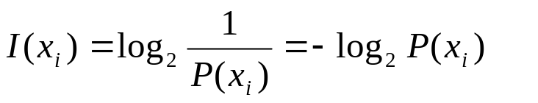
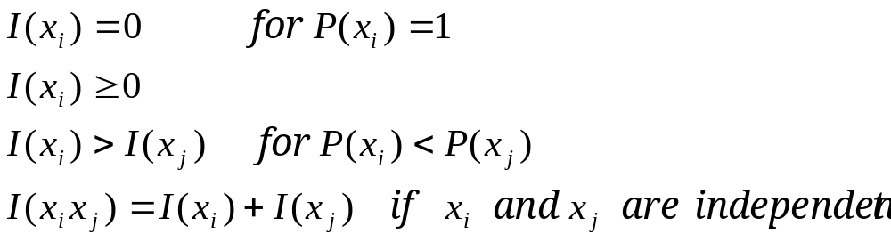
Information Theory
Information Theory: quantitative measure of the amount of information contained in message signals and determination of data transfer capacity of the communication channel.
The amount of information contained in a message signal greatly depends on its uncertainty.
Messages containing knowledge of high probability of occurrence convey relatively little information.
→ Information is proportional to the uncertainty of an outcome
If there is a set of M symbols {x₁ , x₂ , … , x_{M}}, the information content of symbol x_{i} denoted by I(x_{i}) is defined as:
where P(x_{i}) is the probability of occurrence of symbol x_{i}. Unit: bit
With:

Slide 3
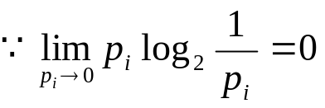
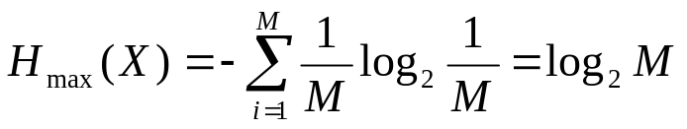

Information Theory
Average information, entropy
Suppose we have M different and independent symbols, {X: x₁ , x₂ , … , x_{M}}, with respective probabilities of occurrence: {p₁ , p₂ , … , p_{M}},
Consider a long sequence of symbols is generated and transmitted, the mean value of I(x_{i}) is:
where H(X) is called the entropy of source X. It is a measure of the average information content per source symbol. Unit: bit per symbol
When p_{i}=1, H(X) = 0. When p_{i}→ 0, H(X) → 0
Maximum entropy occurs when all symbols are equally probable, i.e. p_{i}=1/M for all i=1,…,M ,
Thus,

Slide 4
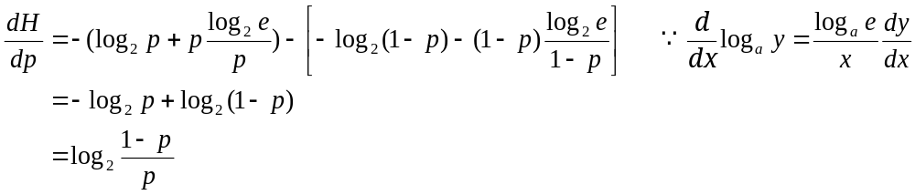
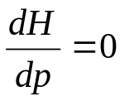
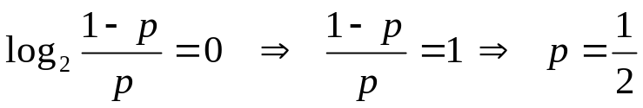
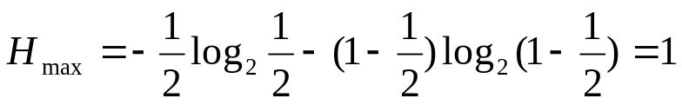
Information Theory
Example: When there are two symbols with probability of occurrence: p and (1-p) ,
The entropy is:
Consider
For maximum value of entropy H:
Thus,
H
1
When p=1, H=0. When p→ 0, H→ 0.
0
½
1
p

Slide 5

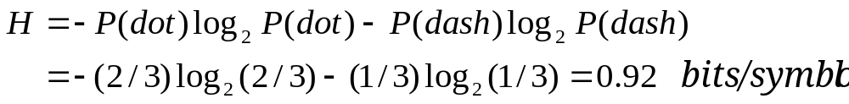

Information Theory
Information Rate
If the source X generates the messages at the rate of r symbols per second, the information rate R is defined as:
Example: Consider a telegraph source having two symbols, dot and dash. The dot duration is 0.2s. The dash duration is 3 times the dot duration. The probability of the dot’s occurrence is twice that of the dash, and the time between symbols is 0.2s. Calculate the information rate of the telegraph source.
Solution:
Average symbol rate
Average information rate

Slide 6
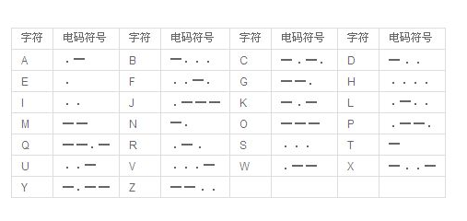
Morse Code

Slide 7

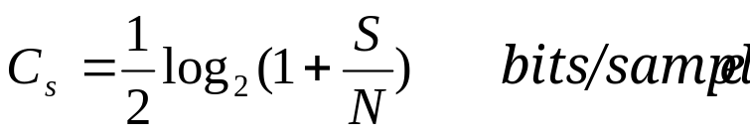
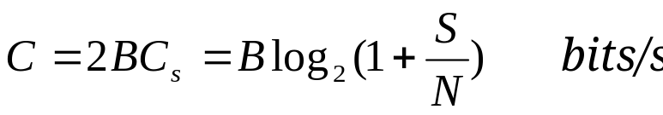

Information Theory
Channel Capacity
Consider an additive white Gaussian noise (AWGN) channel,
X: channel input, Y: channel output,
n: additive band-limited white Gaussian noise with zero mean and variance σ_{n}².
The capacity C_{s} of an AWGN channel is given by:
where S/N is the signal-to-noise ratio at the channel output. S is the signal power and N is the total noise power within the channel bandwidth.
If the channel bandwidth is B Hz , the output y(t) is also a band-limited signal completely characterized by its periodic sample values taken at the Nyquist rate 2B samples/second.
Shannon-Hartley Law
where , η/2 is the noise power spectral density (two-sided)

Slide 8
AWGN
(Additive White Gaussian Noise)
A basic and generally accepted model for thermal noise in communication channels, is the set of assumptions that
  the noise is additive, i.e., the received signal equals the transmit signal plus some noise, where the noise is statistically independent of the signal.
  the noise is white, i.e, the power spectral density is flat, so the autocorrelation of the noise in time domain is zero for any non-zero time offset.
  the noise samples have a Gaussian distribution.
Mostly it is also assumed that the channel is Linear and Time Invariant. The most basic results further assume that it is also frequency non-selective.

Slide 9
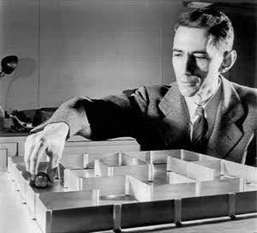
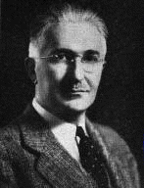
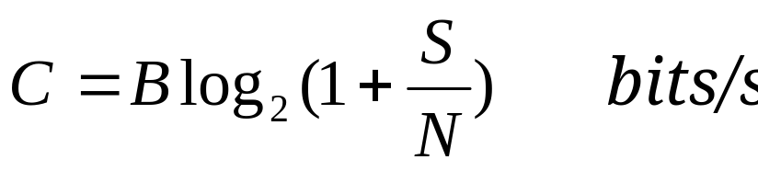
Information Theory
Channel Capacity
Claude Shannon
Ralph Hartley
Shannon-Hartley law indicates that a noiseless Gaussian channel (S/N=∞) has an infinite capacity.
For practical AWGN channel, the noise will limit the channel capacity.
Examples:
If the SNR is 20 dB, and the bandwidth available is 4 kHz, which is appropriate for telephone communications, then C = 4 log ₂ (1 + 100) = 4 log ₂ (101) = 26.63 kbit/s. Note that the value of 100 is appropriate for an SNR of 20 dB.
If it is required to transmit at 50 kbit/s, and a bandwidth of 1 MHz is used, then the minimum SNR required is given by 50 = 1000 log ₂(1+S/N) so S/N = 2^{1/20} -1 = 0.035 corresponding to an SNR of -14.5 dB. This shows that in some sense it may be possible to transmit using signals below the noise level, using wide bandwidth communication, as in spread spectrum communications.
Ref: http://www.encyclopedia4u.com/s/shannon-hartley-law.html

Slide 10
Information Theory
Channel Capacity
Given a source of M equally likely messages, with M >1, which is generating information at a rate R.
Given a channel with channel capacity C.
  If R ≤ C, there exists a coding technique such that the output of the source may be transmitted over the AWGN channel with an arbitrarily small probability of error in the received message.
  If R >C, the probability of error is close to unity for every possible set of M signal symbols, i.e., M ↑ ⇒ P_{e} → 1

Slide 11
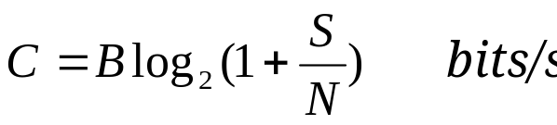
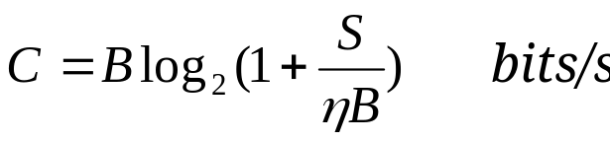
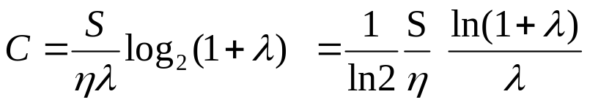
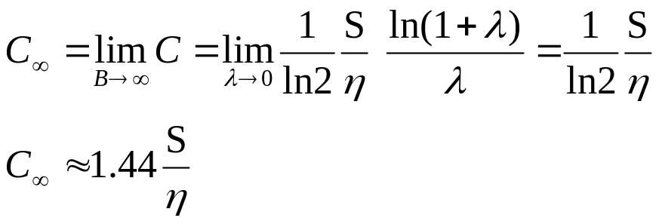
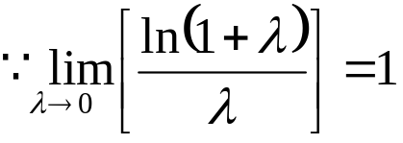
Information Theory
Channel Capacity
where , η/2 is the noise power spectral density (two-sided).
i.e.
The channel capacity does not become infinite as the bandwidth becomes infinite. (increase in bandwidth will lead to increase in noise)
Let S/(ηB)=λ →
Consider B→∞ , i.e. λ → 0
Trade-off between SNR and bandwidth
e.g. If SNR=7, B=4kHz → C=12kbit/s. If SNR=15 and B=3kHz → C=12kbit/s

Slide 12
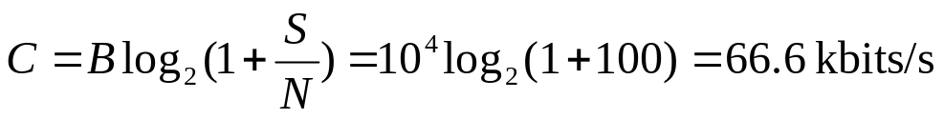

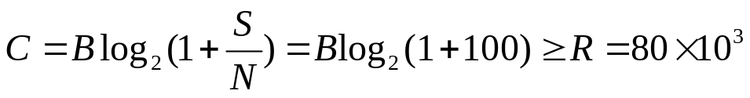
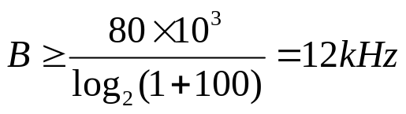
Information Theory
Example: An analog signal having 4-kHz bandwidth is sampled at 1.25 times the Nyquist rate, and each sample is quantized into one of 256 equally likely levels. Assume that the successive samples are statistically independent.
S/N ratio of 20dB and channel bandwidth B=10kHz
Is error-free transmission possible?
Nyquist rate=2(4000) = 8000 samples/s
Symbol rate r=8000(1.25)=10⁴ samples/s
Entropy H(X)=log₂256=8 bits/sample
Information rate R=rH(X)=10⁴(8) = 80 kbits/s
For S/N ratio of 20dB and channel bandwidth B=10kHz
Channel capacity
, error-free transmission is not possible.
For error-free transmission (R≤ C) with S/N ratio is 20dB,
Required channel bandwidth

Slide 13
MIT Open Course
http://open.163.com/movie/2011/7/0/E/M852AB9GH_M8ACAM90E.html

